Slide 1
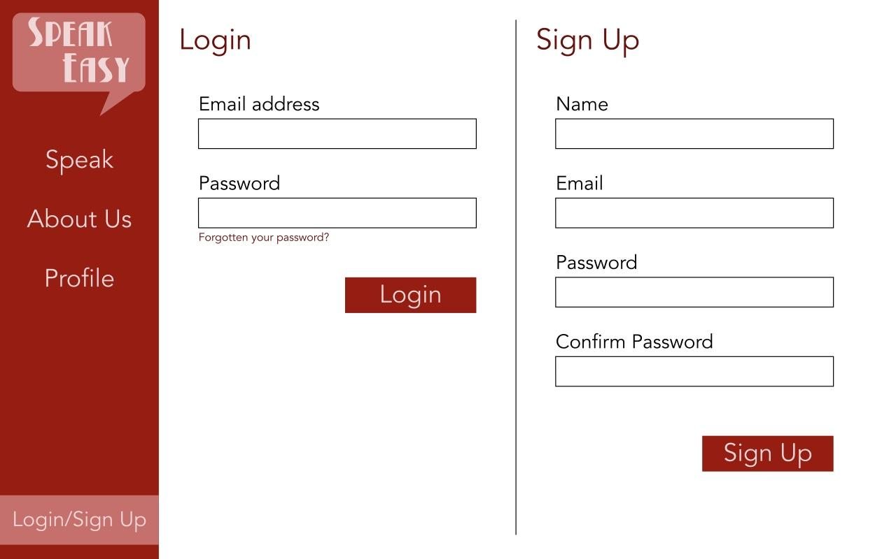
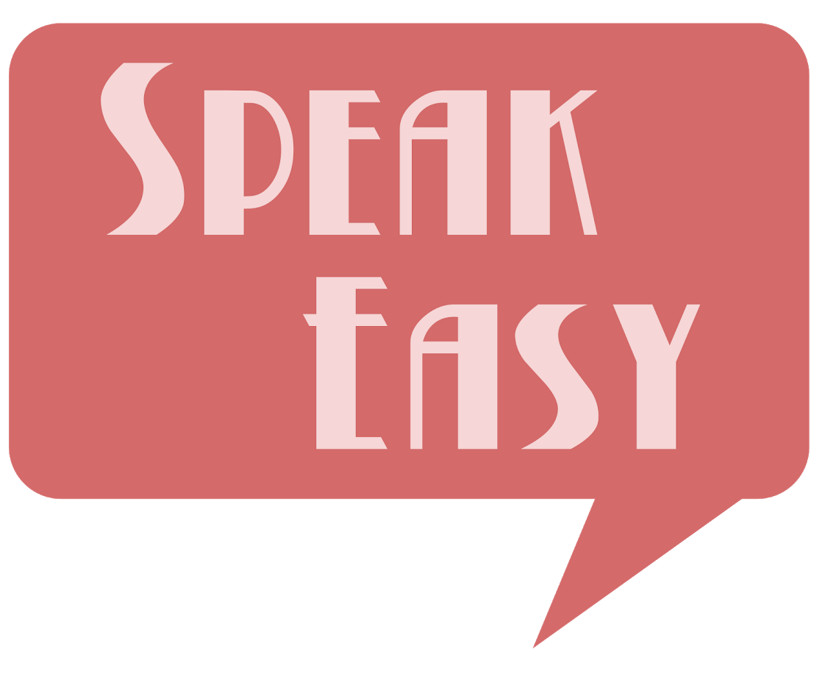
SpeakEasy - Predictive Text meets Text-to-Speech
Final Presentation by X4

Slide 2
Our App

Slide 3
The Wonders of SpeakEasy
Dynamic Text-to-speech application that can be used by everyone.
Web based application
Converts typed text to live speech
Ability to customize and insert favourite words and phrases
Predictive and intuitive
“Don’t let them prohibit your voice”
Live Demonstration

Slide 4
Interesting Features
Well thought out keybindings that allow the user to type with speed
Word suggestions feature that aims to additionally increase the speed in which you can communicate via the application
Up to five customizable keyboards which the user can change to insert frequently used phrases

Slide 5
How It Works

Slide 6




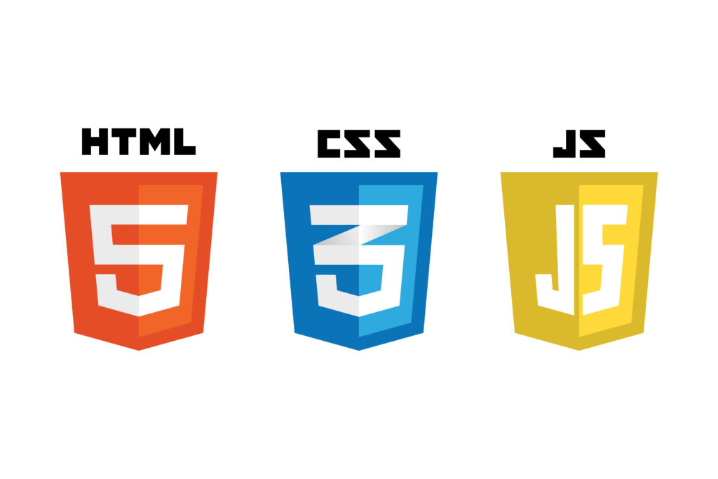


Program structure
Text to Speech API
Backend
API routes
Word suggestion
Routes
User interface
ORM
Database

Slide 7


Software stack
Backend
Python
Flask
MySQL
Flask-SQLAlchemy
Flask-login
Google (python package)
Frontend
HTML
CSS
Jinja
JavaScript
Word suggestion
Tensorflow
Keras
NLTK

Slide 8

Database schema
User
id
username
email
password_hash
accent
gender
speed
UserKeyboard
id
user_id
keyboard_id
Keyboard
id
icon
phrase1
phrase2
phrase3
position

Slide 9
How We Built It

Slide 10
Tools and Techniques
Communication
WhatsApp
Trello
OneNote
Development tools
All used different code editors
Designed to work on Linux
UI mockups done in Inkpad
We chose not to use the Bootstrap CSS framework
Development techniques
Working in the same lab/area
Testing constantly
Planning UI design in advance

Slide 11
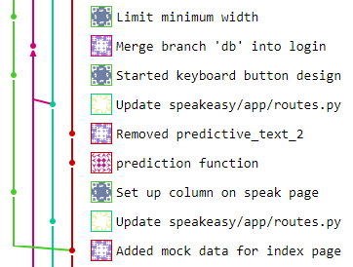
Managing the Codebase
Using Git
We split the development into several branches, and had 1 or 2 people working on each branch.
Design
Prediction
DB
Login
Splitting into files
Shared a single CSS file for all styling
One main JavaScript file for application code
Base Jinja template holding the navigation bar
Extra templates for each page inheriting from this
Some JavaScript in these that varied depending on the data used to render the template

Slide 12
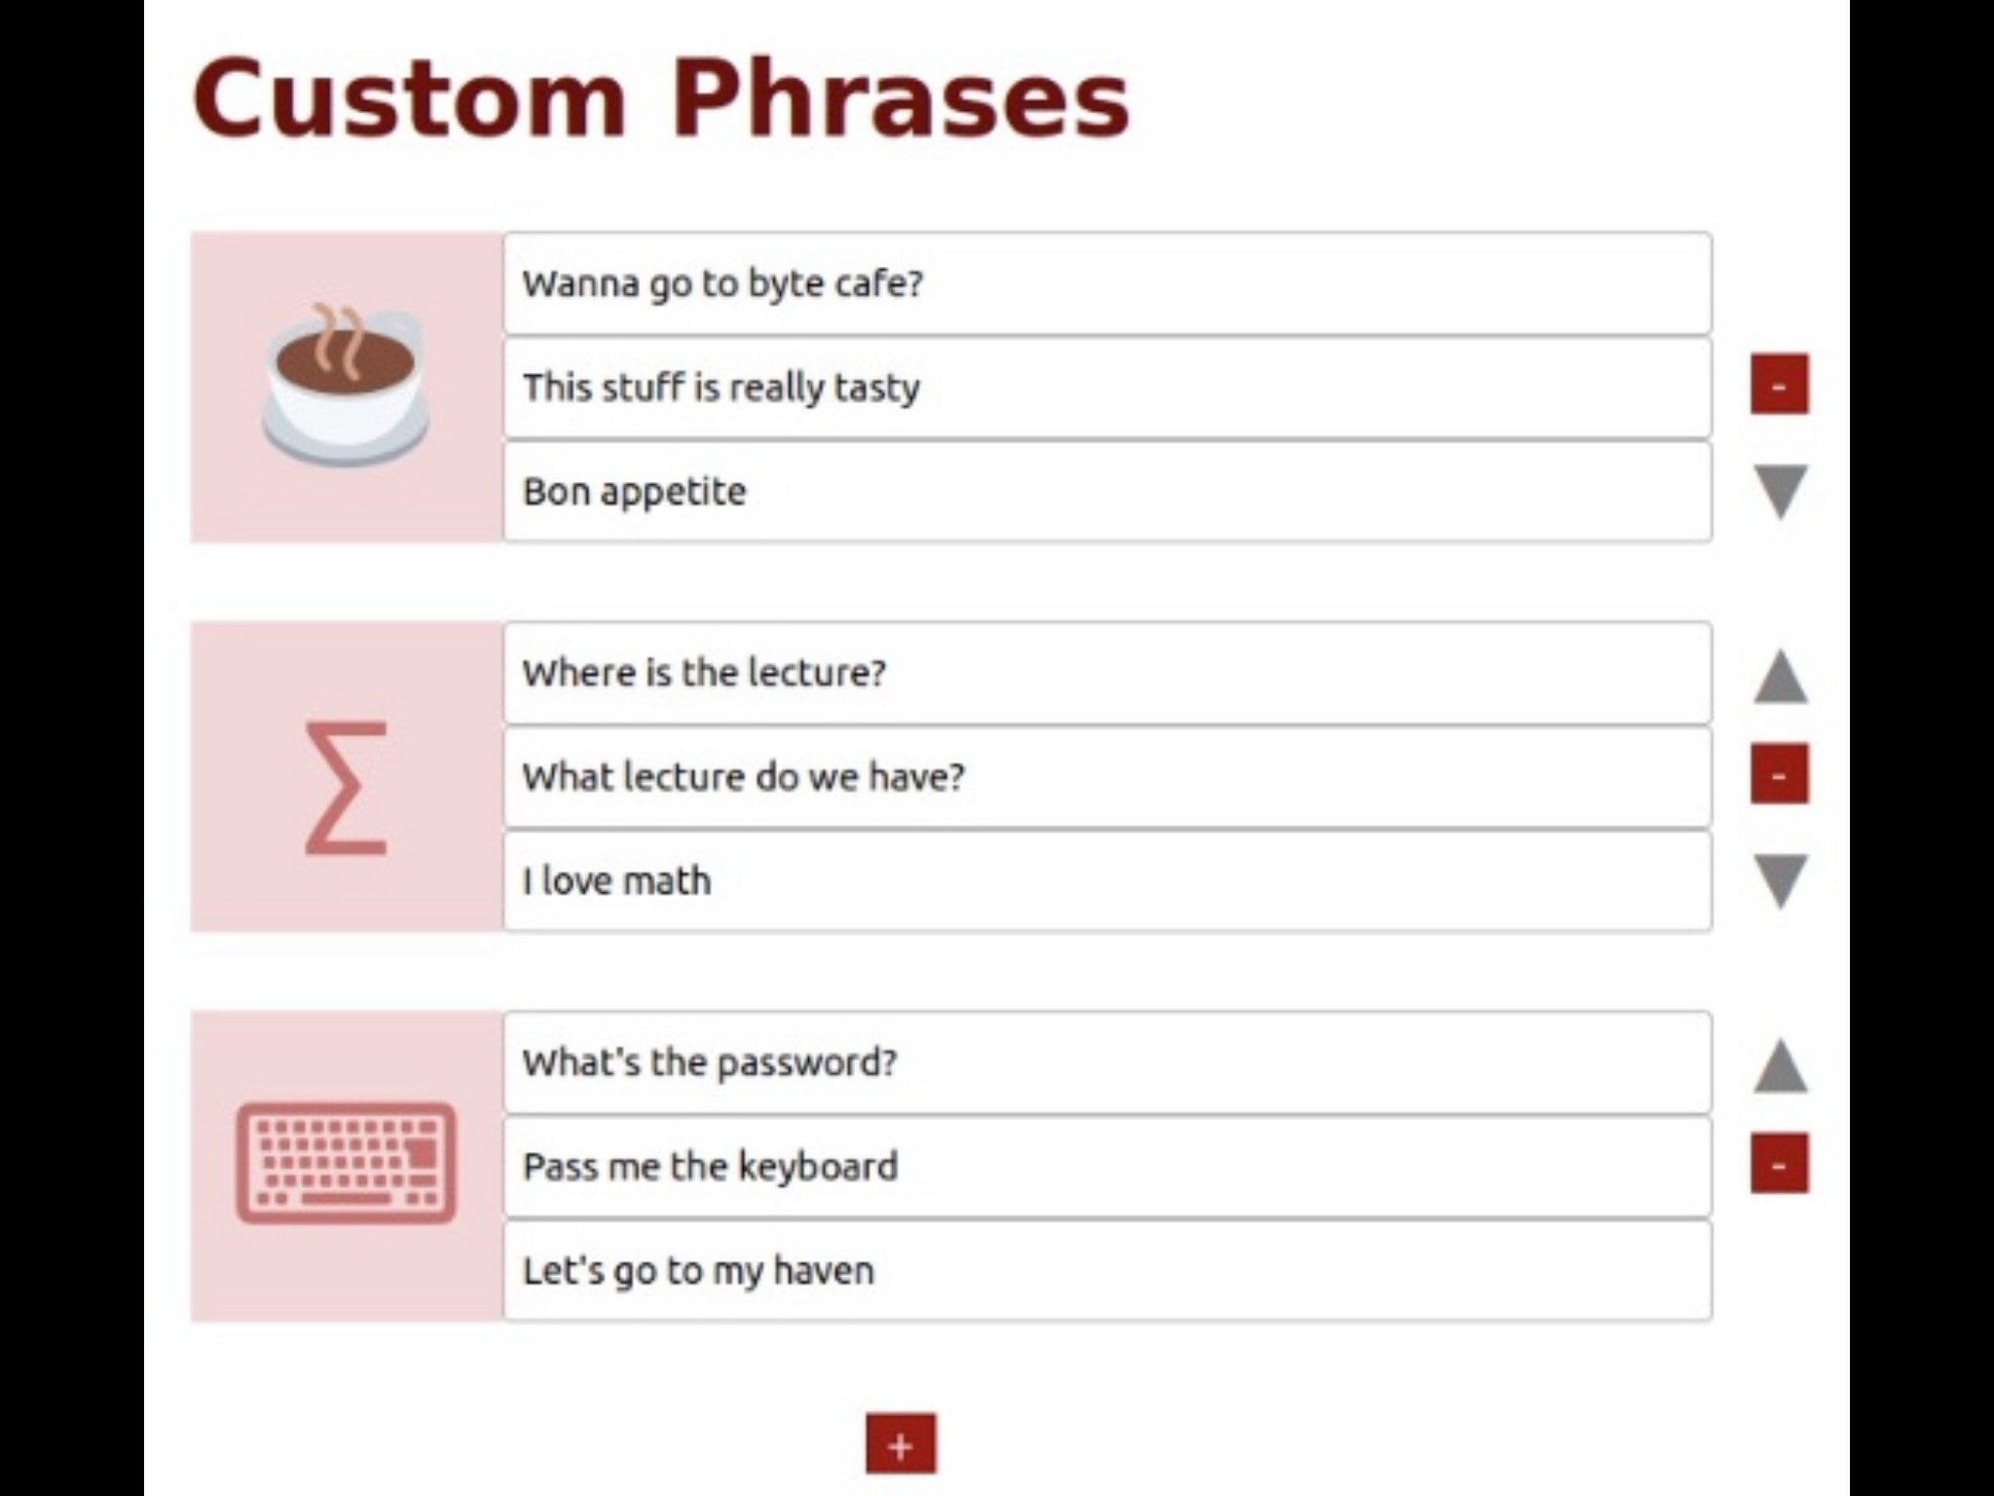
Important Decisions
Division of the system into components
Predictive text feature was kept largely separate until the end
Database and validation were separate but communicated a lot
Designing the database
Use of MySQL
Table to link between users and their keyboards
We hosted the database on Kilburn
Customisation options
Exactly 3 phrases per keyboard
Between 1 and 5 keyboards
Set of possible Unicode icons

Slide 13
How We Organised It

Slide 14
Decision Making and Ensuring Progress
Regularly discuss important decisions to ensure everyone on same page
Smaller decisions about individual/group work kept between those small teams
Larger decisions (e.g. core concepts) discussed as a whole team
Deadlines set for decisions to be made by in order to keep work flowing
Milestone deadlines set to ensure clear stages in development

Slide 15
Team Organisation
Frontend
Miranda - User interface design
Natalia - Design implementation
Backend
Yordan - Key bindings implementation
Lukas - Implementing Google APIs
Alex - Profile page
Rakha - Databases, validation
Ed - Implementation of predictive text

Slide 16
Distributing Work
Tasks/areas of work set based on experience and interests of team members
People either knowledgeable or interested in a section of work would focus on those areas
Generally leads to higher quality of work with a flatter learning curve

Slide 17
Integration
Multiple git branches aimed to keep work modular and developed concurrently
Deadlines for integration set between smaller teams to make sure their work fit together
Larger merges done during labs for easy discussion
Also acted as a weekly deadline to keep us moving forward
Communication between teams was very important for smooth integration
Regular tagged git commits were very helpful for tracking progress - keeps it clear and organised

Slide 18
Ethical and Legal Issues
Data protection taken into account
Only information stored is what is required for accounts as well as pre-saved sentences
Information that users type not stored (could’ve been used for training)
Generally allowed us to progress as we wished due to few ethical/legal concerns

Slide 19
Reflection:
What would we change?

Slide 20
Technical Changes: Front End
Add a more dynamic way of editing the keyboards → drag & drop interface, maybe some animations?
More back-end integration with the front-end side. → easier for code refactoring & future changes

Slide 21
Technical Changes: Back End (1)
Document what every method does, and its flow
Understand `git` more before we use it
Improve the code architecture (ease for extensibility & refactoring) → main issue for the `user configuration` page → too much code dependency ‘changing one thing breaks all of them’

Slide 22
Technical Changes: Back End (2)
Use a more `robust` training data for predictive text, (e.g. SMS)
Have a more complex neural network, or a combination of them with n-grams
Train the neural network longer with more powerful computer hardware
Have more personalized predictive models

Slide 23
Use of Tools
Use more of Trello and OneNote, as they weren’t used much in retrospect
Use of more ‘professional’ software (e.g. Telegram, Slack) for collaboration → more ‘technical’ features. GitHub, Integration
Lack of tool integration, everything was disconnected → Trello chatbots in our chat rooms?
Familiarize with communication/development tools earlier on

Slide 24
Organizational Changes
Delegate even more work amongst one another, evenly measure the workload
Individually improve time management
Stricter team policy on internal deadlines

Slide 25
Ethical/Legal Changes
We faced no legal issues, as we clarified in our initial project manifesto.
We don’t even store that much personal user data to begin with.

Slide 26
Any Questions?

